Slide 1
Principles of the Baha’i Faith
Oneness of mankind
Universal peace upheld by a world government
Independent investigation of truth
Common foundation of all religions
Harmony of science and religion
Equality of men and women
Elimination of prejudice of all kinds
Universal compulsory education
A spiritual solution to economic problems
A universal auxiliary language

Slide 2
Principles of the Baha’i Faith
Is spirituality a solution for economic problems?

Slide 3
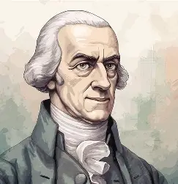
Some background theory
Two main concepts:
The invisible hand (Self interest)
Free market economy (No government intervention)
Notes:
Adam Smith, considered the father of modern economics, also made some basic assumptions in order to provide more goods for man’s needs. Based on his observations, Smith built his theoretical economic system. One of the assumptions he made was that man always acts in his own interests and wants to maximize his satisfaction, so he believed that unfettered self-interest in free-market economies leads to economic prosperity.
The other assumptions Smith mentioned in his famous book The Wealth of Nations included the use of the term “invisible hand,” a metaphor to describe the self-regulation of capitalist markets. He also advocated “laissez-faire economics,” which meant that governments should not interfere and economic markets should be left alone to take care of any problems. He expounded upon how rational self-interest and competition can lead to economic prosperity.
These two fundamental principles of the economic system introduced by Adam Smith were adopted by other economists. The principle of maximizing satisfaction created a sense of individualism which was praised and was the source of inspiration for many.
But this trend of economic thought, without any interference from governments or other agencies, created a breeding ground for greed and exploitation. It resulted in societies which lacked empathy and ignored the plight of the poor and needy. In those societies, the spirit of giving and sharing waned, and gradually the gap between the rich and poor grew greater. Accumulating wealth began to be considered as the highest achievement in a person’s life. Becoming rich became the goal of every man and the cost of achieving this goal was not questioned.
But if the body and its needs become a barrier or hindrance to the progress of the soul, then there is a serious problem. These days, in the economic life of humanity, the body and its wants have taken over the needs and desires of the soul. The servant has become the master, and precious human lives are being wasted in the pursuit of the desires of the body. The Baha’i teachings explain:

Slide 4
Poorest country in the world by GDP:
Central Republic of Africa – largely dependent on the export of diamonds, which brings in between 40-55% of the country’s export revenue. However, it is estimated that up to half of those diamonds are sold on the black market – denying government of tax revenue
$652 per capita per year
Population: 4.7 million
Notes:
The main point of highlighting CAR as the poorest country is the get these points across:
The lack of ethics and corporate governance over this country does not exist. The corruption and greed seen in this country which is really caused by the idea

Slide 5
Scenario A
Scenario B
Person | Income
1 | 600
2 | 620
3 | 640
4 | 660
5 | 680
6 | 720
Person | Income
1 | 100
2 | 120
3 | 150
4 | 180
5 | 200
6 | 3170
Mean income: ____
Mean income: ____

Slide 6
Richest country in the world by GDP:
United States of America – reasons behind its success include its larges domestic automotive industry, a technological sector that fosters innovation, and a system of democracy that protects entrepreneurial and intellectual property rights. However, 51 million families in the US can barely afford food or rent.
$59,495 per capita per year
GDP: 18.57 trillion
Population: 330 million

Slide 7

Top 10% own 70% of US wealth
Unprecedented gap between rich and poor
Jeff Bezoz, Bill Gates, and Warren Buffet (286 bn) = 165,000 americans
Notes:
The main point of highlighting CAR as the poorest country is the get these points across:
The lack of ethics and governance over this country shows us the corruption. The greed, the

Slide 8
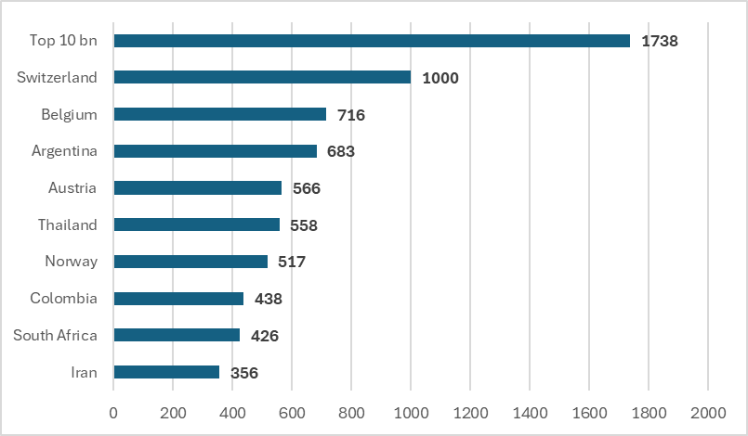
Notes:
The main point of highlighting CAR as the poorest country is the get these points across:
The lack of ethics and governance over this country shows us the corruption. The greed, the

Slide 9
The effect of wealth disparity
Slower economic growth
Promotes welfare states (Food stamps, housing commission)
Disruption of social cohesion
Notes:
Highest rates of youth unemployment – Greece Italy frace

Slide 10
Is there a solution?
No solution can be found to solve the problem of disparity if the principle of justice and fairness has not been upheld by individuals communities and institutions of our societies
Notes:
Talk about the chimpanzee example and how it is within the DNA of our creation to be fair.

Slide 11
“O Son of Spirit!
The best beloved of all things in My sight is Justice, turn not away therefrom if thou desires Me, and neglect it not that I may confide in thee. By its aid thou shalt see with thine own eyes and not through the knowledge of thy neighbour.”
“There can be no doubt whatever that if the daystar of justice, which the clouds of tyranny have obscured, were to shed its light upon men, the face of the earth would be completely transformed.”
- Baha’u’llah
Notes:
Highest rates of youth unemployment – Greece Italy frace

Slide 12
Baha’i Perspective
Regard the world as a human body.
In the human body, the cooperation ensures the function of the system. Similarly, civilization can be seen as the set up interaction of the closely integrated yet diverse component. Components which have transcended the narrow purpose of tending to their own existence.
Notes:
Every single cell works, and every organ that works independently although works ndependently but they work in close coopereation of each other. If one cell doesn’t function, then all the other parts of the body is becoming dysfunctional
In the Writings – is there a Bahai economic system?
No we don’t. We don’t. Baha’u’llah brought the Writings and Shoghi Effendi expounds on this more – in UHJ world governing body in future will bring expert in the field of economy, sociology, politics, after they have investigated and studied the entirety of the fatih will band together and come up with a system that will be the future world order WRT to religion and spiritual principles. So, when is that going to happen? The time? We do not know.
But one thing we do know, is that the Bahai community all around the world is engaging with over 5000 localities around the world with the process (institute process for children education) – empowering JY and children – to plant the seed of the new world order and the new race of man – create a people that they do believe in righteousness, in truthfulness , that ultimately they can adopt every single virtue in our daily lives and in our business.
If we understand that every talent and faculty that each one of us has, is for one single purpose, and that single purpose is purely for the purpose of the others – then the world is not about accumulating wealth but it is about the service to others and how we can stretch our hands to others and how we can create a community that we are proud of.
(Example of Ceasar) – if we now understand that our purpose in this world is not about accumulating the wealth or how rich you are. But about the effect that you have and the social cohesion with the people that crosses our paths – that we believe what the Bahais are currently doing
Guardian says: Apart form supporting government intervention, to correct all types of market failures through legislation – there are enumerous ethical and spiritual principles that influences individual and business to have a new way of thinking or to have a different lifestyle behaviour.
Further,
The Baha’i vision is working towards an ever-advancing civilization and service to humanity. There is a clear and universal holistic view of multi-dimensional approach – today, we see a glimpse of unfolding change as the disparity between the extremes of wealth and poverty show a widening gap illustrating that the statement of the global society is concerned about the future sustainability of the world economy. There are more fair and just balance
-
UHJ states: The primary concentration is the spirit that has permeate our economy life and will gradually crystallize itself that will define institution and the principle that will help to bring about the ideal condition foretold by Baha’u’llah
Overall – the guidance we receive around the virtues – it will come to the point in summary the current definition of our economic frameworks may not work with the Bahai approach. Go to the politician (it is a foreign concept) – chariman of public company – it is in my function/purpose to act within the interest of my shareholder – it cannot be to look after those that we buy the property from
It is perspective to rethink, educational purpose , the school system we currently have created – is based on how we compete on each other based on intelligence – give to the more intelligent to give them scholarship – we don’t stop to think when they graduate from the school – what kind of human did we create
How bad might they be professionally but how good might they can be as a human being
Compulsory education is not to create professionals.
In conclusion -

